Slide 1
Python
Tuple, Set & Dictionary
in programming

Slide 2
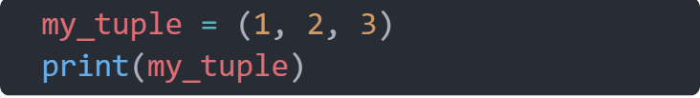
TUPLES
What is a tuple?
A tuple in Python is similar to a list.
A tuple is created by placing all the items (elements) inside parentheses ()
The difference between the two is that we cannot change the elements of a tuple once it is assigned whereas we can change the elements of a list.
A tuple can have any number of items and they may be of different types

Slide 3
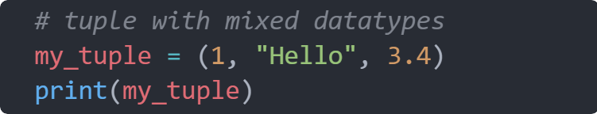
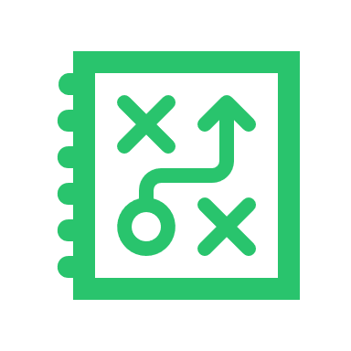
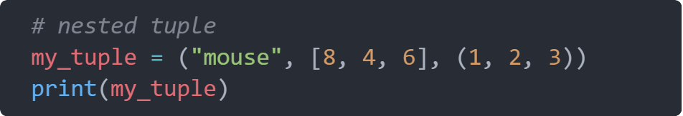
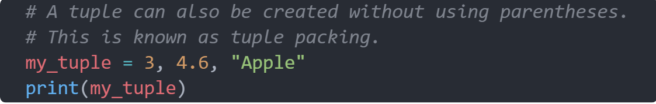
TUPLES
More tuple examples

Slide 4
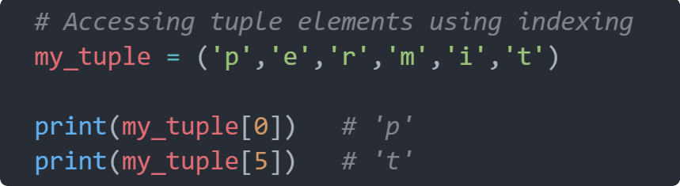
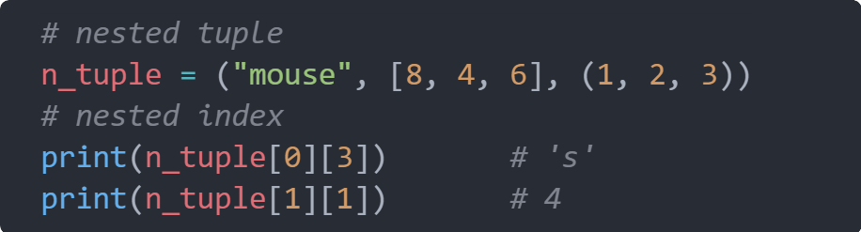
TUPLES
Indexing
We can use the index operator [ ] to access an item in a tuple, where the index starts from 0.
The index must be an integer, so we cannot use float or other types. This will result in TypeError

Slide 5
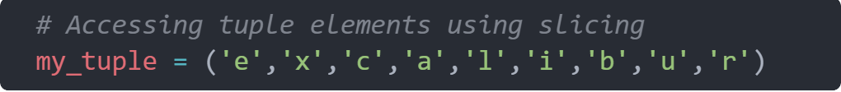
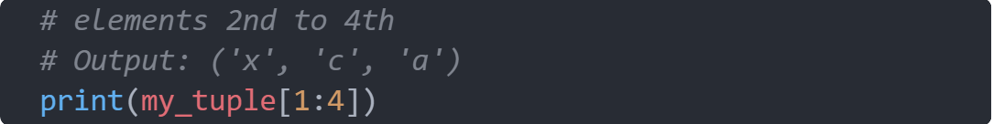
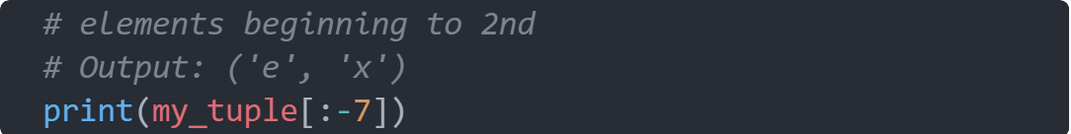
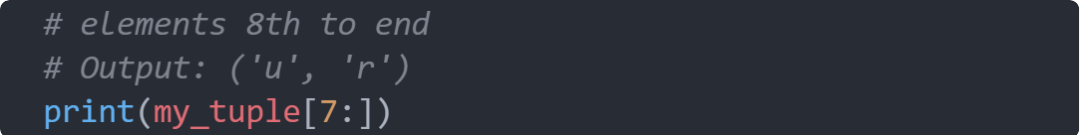
TUPLES
Slicing
We can access a range of items in a tuple by using the slicing operator colon :

Slide 6
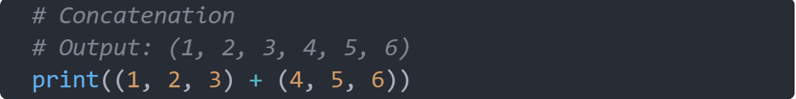
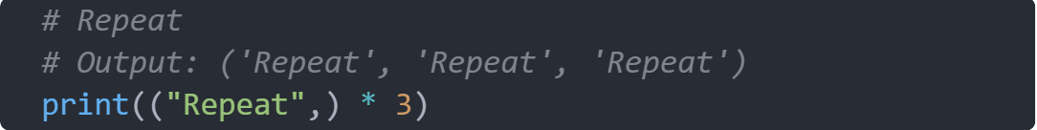
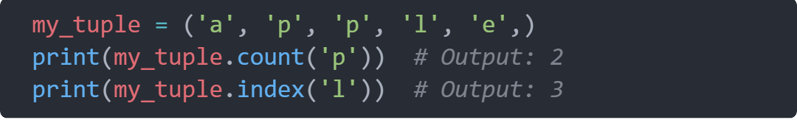
TUPLES
Other operations

Slide 7
SET

Slide 8
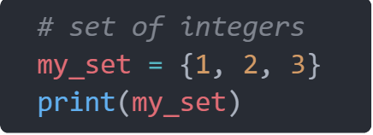
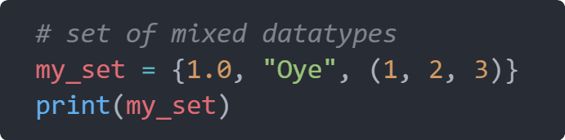
SET
A set is an unordered collection of items. Every set element is unique (no duplicates)
What is a set ?
1
Sets can also be used to perform mathematical set operations like union, intersection, symmetric difference, etc
2
a set itself is mutable. We can add or remove items from it

Slide 9
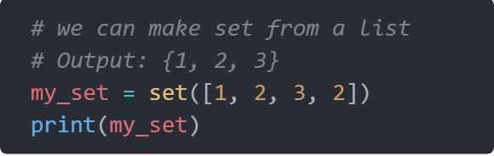
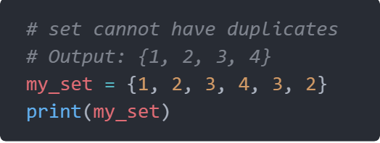
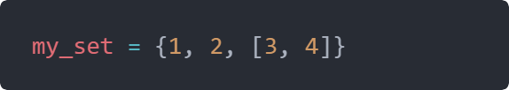
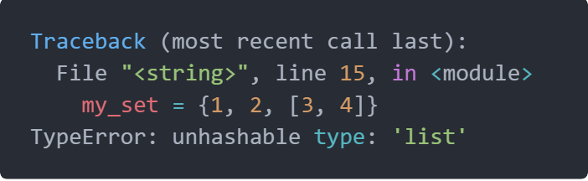
SET
1
Creating a set
2
3
set cannot have mutable items
# here [3, 4] is a mutable list
# this will cause an error.

Slide 10
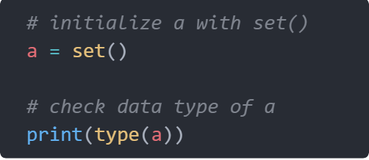
SET
Creating a empty set is a bit tricky
To make a set without any elements, we use the set() function without any argument

Slide 11
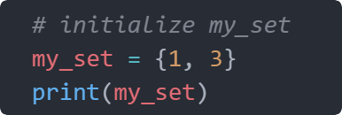
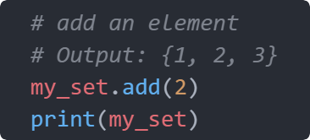
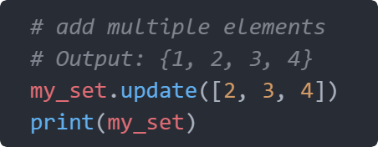
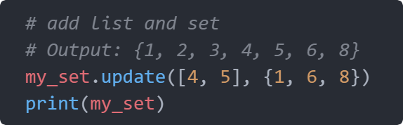
SET
Modifying a set
1
Sets are mutable. However, since they are unordered, indexing has no meaning.
2
3
4

Slide 12
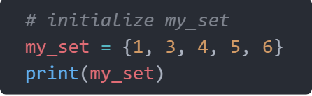
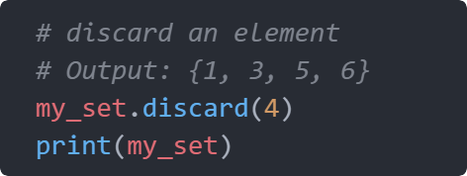
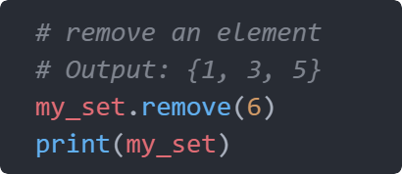
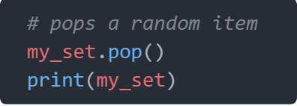
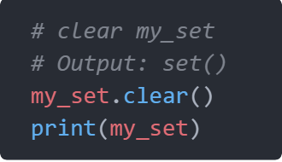
SET
Removing items from set
1
A particular item can be removed from a set using the methods discard( ) and remove( )
2
same
3
4
5

Slide 13
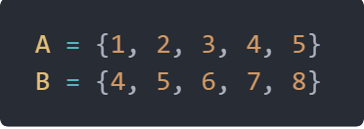
SET
Python set operations
Lets take these sets
Sets can be used to carry out mathematical set operations like union, intersection, difference and symmetric difference.

Slide 14
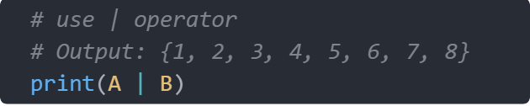
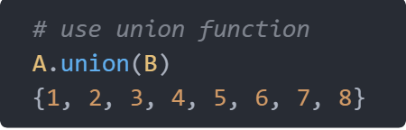
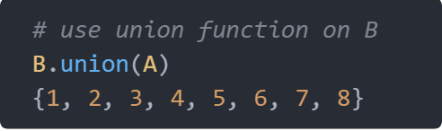
SET
Set Union
1
2
3
4

Slide 15
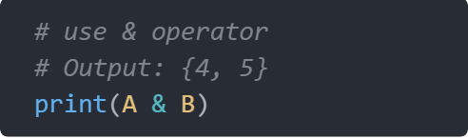

SET
Set Intersection
1
2
3

Slide 16
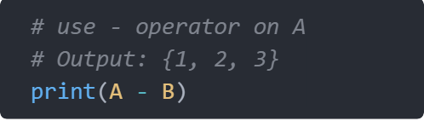
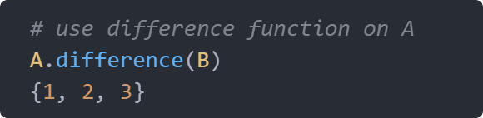
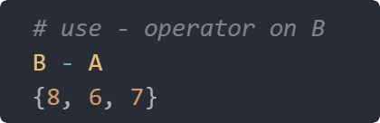
SET
Set difference
1
2
3
4

Slide 17
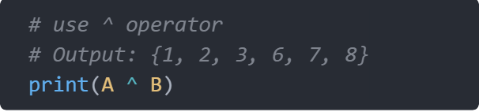
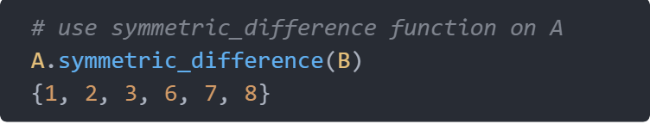
SET
Set symmetric difference
1
2
3

Slide 18
DICTIONARY

Slide 19
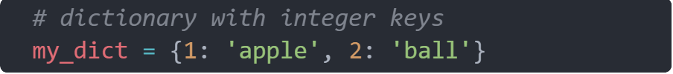
DICTIONARY
What is a dictionary ?
Each item of a dictionary has a key/value pair.
Python dictionary is an ordered collection of items.
An item has a key and a corresponding value that is expressed as a pair (key: value).
Dictionaries are optimized to retrieve values when the key is known.

Slide 20
DICTIONARY
Accessing Elements from Dictionary
While indexing is used with other data types to access values, a dictionary uses keys. Keys can be used either inside square brackets [ ] or with the get( ) method
If we use the square brackets [], KeyError is raised in case a key is not found in the dictionary. On the other hand, the get() method returns None if the key is not found

Slide 21

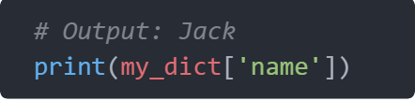
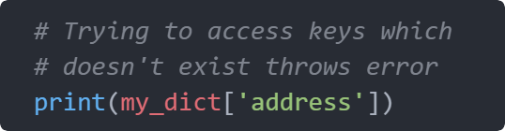
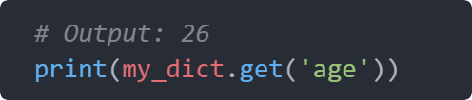
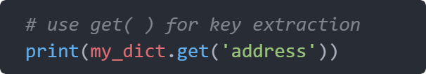
DICTIONARY
Accessing Elements from Dictionary
1
2
4
3
5

Slide 22
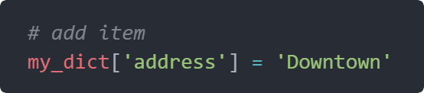
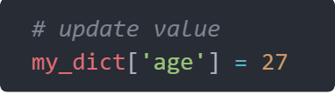
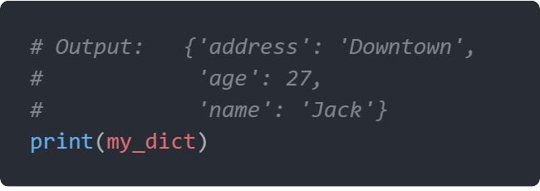
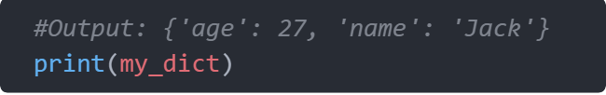
DICTIONARY
Modifying Elements from Dictionary
3
1
4
2

Slide 23
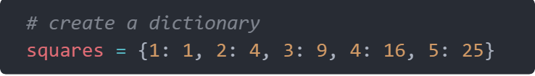




DICTIONARY
Removing elements from Dictionary

Slide 24



DICTIONARY
Iterating Through a Dictionary

Slide 25
THE END

